Slide 1
Additional Budgeting Concepts– Forecasting
September 22, 2022
Wenchen Wang

Slide 2
Forecasting
Forecasting is important in the budgeting process.
Forecasting is done using three approaches
Subjective methods (e.g., Delphi and nominal group) when there are no historical data.
Time Series methods when the future is expected to follow an historical trend.
Causal Modeling which tries to forecast based on statistical relationships among several factors.
Notes:
Budgets are detailed action plans for the organization for a future period. In order to successfully establish a budget, estimates of expenses and revenues are equally important. Consider, for example, a school budget. The budget will depend on the number of students. Part of the school budget is the cost maintain school buildings. That cost will depend on the average temperature throughout the winter. Part of the school budget may depend on the average price of textbooks. These are just a few of the many expense expectations in a school budget. The future depends on many unknown factors and events. When managers develop budgets, they must make predictions called forecasts.
In subjective forecasts,a team or panel must be selected that consists of individuals who are likely to have reasoned insights with respect to the item being forecast. Industrial experience has shown that by arriving at a consensus among a team of experts, subjective forecasts can be reasonably accurate. The experts do not have to be expert in the specific project, but they should come from areas as closely related as possible.

Slide 3
Subjective Forecasting
The nominal group approach
Combination of different insights
Lack of information & Biases
Delphi techniques
Avoid confrontation and has more logics
Takes more time and is more cumbersome
Notes:
In subjective forecasts, a team or panel must be selected that consists of individuals who are likely to have reasoned insights with respect to the item being forecast. Industrial experience has shown that by arriving at a consensus among a team of experts, subjective forecasts can be reasonably accurate. The experts do not have to be expert in the specific project, but they should come from areas as closely related as possible.
The nominal group technique is one in which the group members are brought together in a structured meeting. Each member writes down a forecast. Then all the written forecasts are presented to the group by a group leader without discussion. Once all the forecasts have been revealed, the reasoning behind each one is discussed. After the discussions, each member again makes a forecast in writing. Through a repetitive process, eventually a group decision is made.
By using a group approach, a number of individuals focus their attention on the same problem. Each person has a somewhat different perspective that influences his or her subjective forecast. Being exposed to competing forecasts and explanations of the reasoning behind them can be extremely helpful in providing the central planner with insights that had not already been considered. The underlying concept is that both the additional ideas and the discussion of the ideas by all members of the group will result in an improved forecast.
the nominal group technique has weaknesses. One problem involves lack of information. If different individuals base their forecasts on different assumptions, it may be impossible to reach consensus. A more serious problem involves politics and personalities. As members of the group defend their forecasts, extraneous issues having to do with whose idea it is may bias the group decision. Some individuals may be reluctant to share their ideas in public for a variety of reasons.
In the Delphi approach, the group never meets. All forecasts are presented in writing to a group leader, who provides summaries to all group members. After several rounds, a decision is made based on the collective responses. The weakness of the Delphi method is that it takes more time and is more cumbersome than the nominal group method. Nevertheless, Delphi has several particular advantages. By avoiding a face-to-face meeting, the technique avoids confrontation. Decisions are based more on logic than on personality or position.

Slide 4
Quantitative Forecasting
Causal Models: changes in one variable are used to predict changes in another.
Time-series Models: one variable are used to predict changes in another.
Notes:
In causal models changes in one variable are used to predict changes in another. For example, Meals can examine how much the amount of food it used in past years changed as the number of meals served varied. Based on that relationship, it can predict how much food will be needed in the coming year if it has an expectation of the number of meals that will be served in the coming year. Changes in the number of meals cause a change in the amount of food needed.
In time-series models there is assumed to be a relationship between the item we wish to forecast and the passage of time. For example, Meals may believe that the best indicator of the number of meals to be served in the future is simply the underlying trends that occur over time.

Slide 5
Regression Analysis
Independent/Dependent Variables
Ordinary Least Squares analysis
Cautions
Plausibility
Goodness of Fit
Statistical Significance
Reasonableness of Assumptions
Outliers
Notes:
Linear regression, using a technique called the ordinary least squares (OLS) method, attempts to find a straight line that comes as close as possible to all the historical points. The underlying concept is that if the line we find comes close to the historical points, it is likely to come close to the actual future values for the variable we are predicting as well.
Plausibility: Regression analysis uses a relationship between two variables as a basis for prediction. However, it is important to assess whether it makes sense that one variable would be predictive of another. There should be some reason that we believe that the independent variable is causal, that it causes the dependent variable to vary. Similarly, if we are using time as the independent variable, and predicting the behavior of some variable over time, we need to have some reason to believe that the relationship makes sense.
Goodness of Fit (R^2): The ability of one variable to explain the variations in another. If the independent variable rises and falls in direct proportion with the dependent variable, the goodness of fit will be excellent. Goodness of fit is usually not perfect because it is rare for one variable to be influenced only by one or several other variables. Usually, some variables that impact the dependent variable are not taken into account in a forecasting model.
Statistical significance: For the independent variable to be responsible for changes in the dependent variable, the cause-and-effect relationship must be significant. T-test to ascertain that the value for the slope is indeed significantly different from 0.
Reasonableness of Assumptions: Specification analysis has four elements: (1) linearity, (2) constant variance, (3) independence, and (4) normality.
Outlier data points are not representative of typical results and can throw off the results.

Slide 6
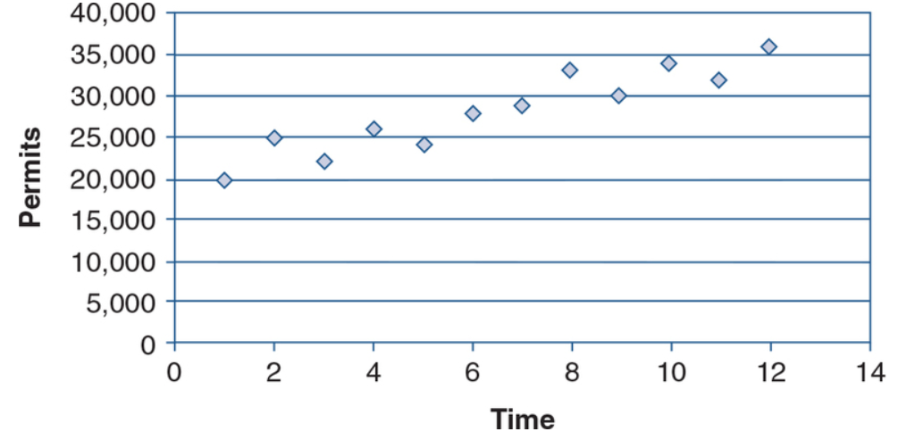
Forecasting Example
Notes:
Time points are for quarter: 1 July-September; 2 October – December; 3 4 (year 1). The graph or chart can help the user get a quick sense of any trends or patterns in the data.
Average approach: Figure 3-B-1 clearly shows an upward trend. Suppose one were to simply average the values of all the data points from Table 3-B-1 and use that average as a forecast for each quarter going into the future. That means we would be predicting the value for each quarter of the coming year to be identical, as the average value of the prior 3 years. That forecast makes little sense given the upward trend observed in Figure 3-B-1.
To improve on forecasts generated by using a simple average, linear regression is often used for forecasting. Regression is a technique that can plot a single line that will provide a reasonably good predictor, based on existing data, for a trend. Regression is used for both causal and time-series analyses.

Slide 7
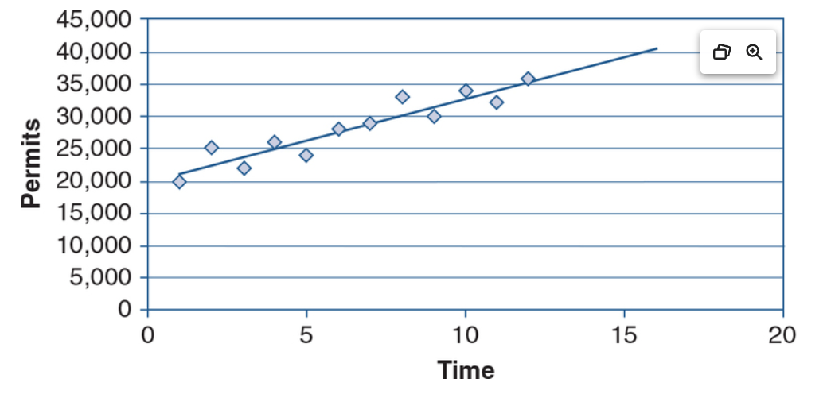
Forecasting Example
Notes:
Historical points probably will not all lie along a straight line. Therefore, the goal of the linear regression process is to estimate a line that is as close as possible to the given data points. Any line other than the regression line would be farther from the historical data points, and therefore likely to be farther from the actual points in the future as well. Most statistical forecasting software programs provide not only a forecast but also a confidence interval for the forecast, which indicates the likelihood that the future result will fall within a given range of values.

Slide 8
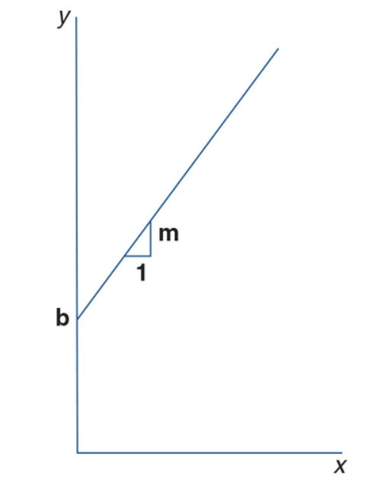

Forecasting Example
Notes:
The OLS model is derived from the equation used to define a straight line:
y=mx + b
where y is the dependent variable, m is the slope of the line, x is the independent variable, and b is the point at which the line crosses the vertical axis, called the y intercept
Clearly, if we know the slope m and intercept b we can predict the future value y (in this case the volume of permits) for any particular time period x. The key is that we generally do not know the values for the slope m and intercept b, and we have to find those values. Linear regression uses a set of paired x and y values to estimate the slope and intercept.
Most statistical forecasting software programs provide not only a forecast but also a confidence interval for the forecast, which indicates the likelihood that the future result will fall within a given range of values.

Slide 9
Using Excel for Forecasting
Create Chart
Add Trendline
Select
Linear
Logarithmic
Polynomial
Power
Exponential
Moving Average

